Slide 1
Electrophysiology methods
Foundations of Cellular Neuroscience
FAES
Spring 2016

Slide 2
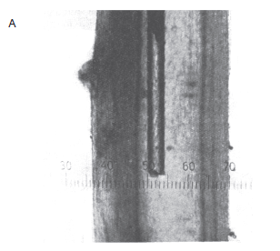
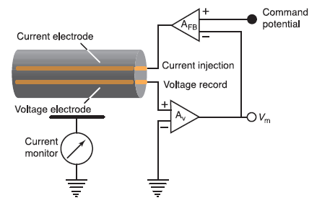
Voltage clamping of squid giant axon

Slide 3
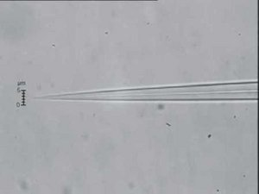
Sharp electrode recordings
High resistance electrode used to puncture the cell. Can be used to record voltage changes and inject current, but does not allow for voltage clamp and examination of currents.

Slide 4

Patch clamp technique

Slide 5
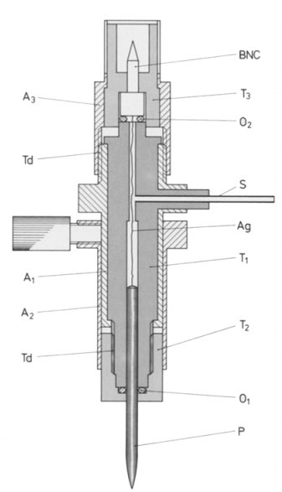
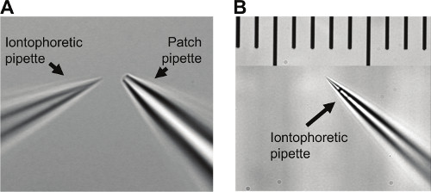
Patch clamp technique
Muller & Remy 2013
Hamill et al., 1981

Slide 6
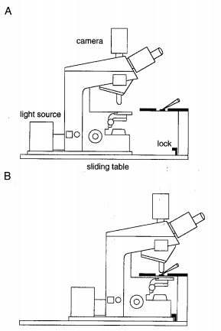
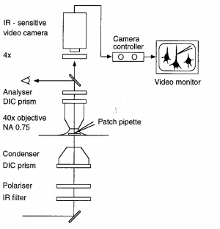
Patch clamp technique

Slide 7
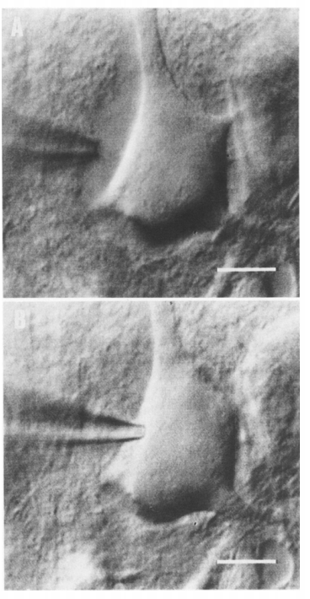
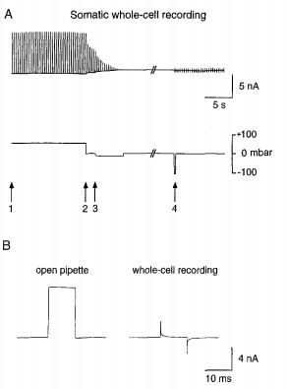
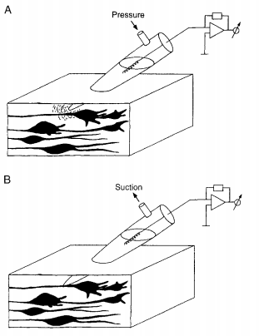
Patch clamp technique

Slide 8
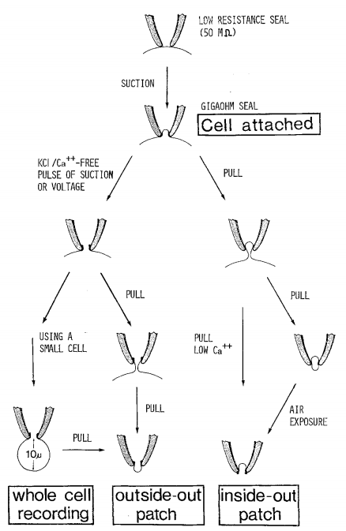
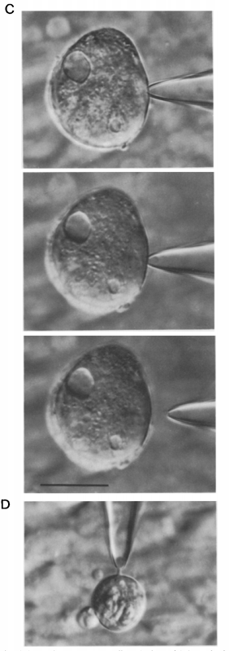
4 common patch configurations
Hamill et al., 1981

Slide 9
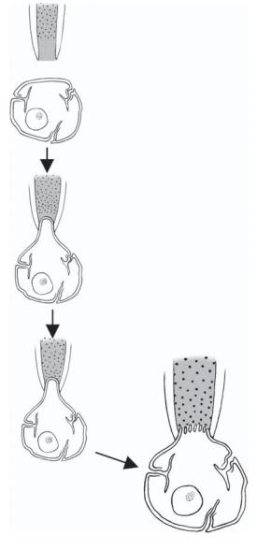
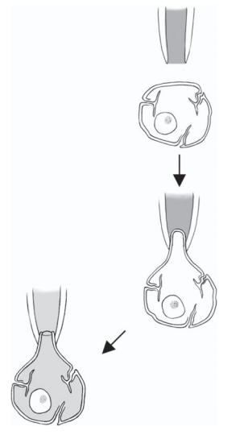
Perforated patches
Sarantopoulos, Neuromethods 2007

Slide 10
Types of recordings
Current clamp
Voltage clamp
Action potential or waveform clamp
Dynamic clamp

Slide 11
Types of recordings
Current clamp
Measure the voltage response of the cell to controlled current injection.
Steps or square pulses of current are common ways to test and characterize neuronal excitability.
It is also possible to inject current waveforms in the shape of synaptic currents (described in later weeks).

Slide 12
Types of recordings
Voltage clamp
Used to measure ionic currents in biological membranes at controlled voltages
Caveats etc. discussed later
Capacitive currents will also be recorded and will be prominent at the onset of voltage steps (I_{C} = C x (dV/dt))
The capacitance of your prep. can be measured and compensated by appropriate circuitry or can sometimes be subtracted out after the recording

Slide 13
Voltage step protocols
Characterizing currents
I-V plots
finding reversal potential
finding conductance
MetaNeuron

Slide 14
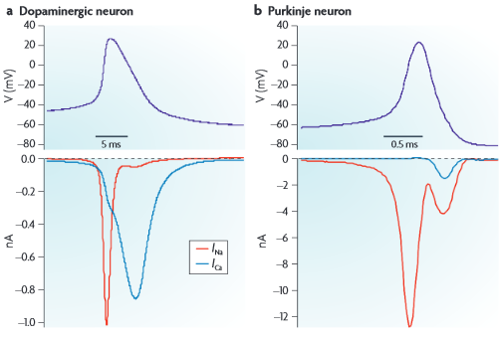
Types of recordings
Action potential clamp
Uses a typical voltage clamp amplifier; however, rather than clamping the membrane to voltage steps, the membrane can be clamped to follow the trajectory of a previously recorded action potential
Can be used with ion channel blockers to reveal activity of currents during the action potential
By clamping the membrane to an action potential waveform, the blockers will not alter the voltage trajectory as they would in current clamp
Bean, “The action potential in mammalian central neurons” Nature Reviews Neuroscience 2007

Slide 15
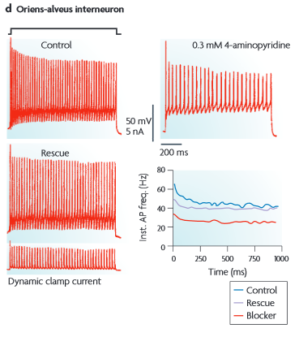
Types of recordings
Dynamic clamp
Used to investigate the effects of adding, subtracting or altering conductances on the firing of the cell
Requires a computational model of your current and a fairly fast computer
Dynamic clamp software continuously tracks the recorded voltage and then injects current according to I = g x (V_{m}-E) where g can be a function of voltage and time.
Bean, “The action potential in mammalian central neurons” Nature Reviews Neuroscience 2007

Slide 16
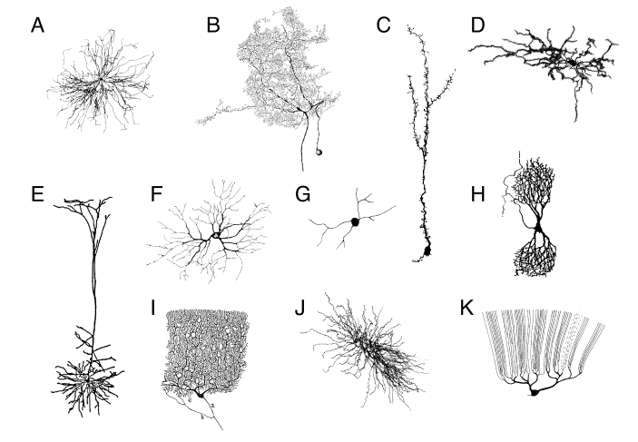
Space clamp
Overcome by Hodgkin and Huxley
But what can we do about elaborate morphologies?
Board discussion of what can happen with poor space clamp.

Slide 17
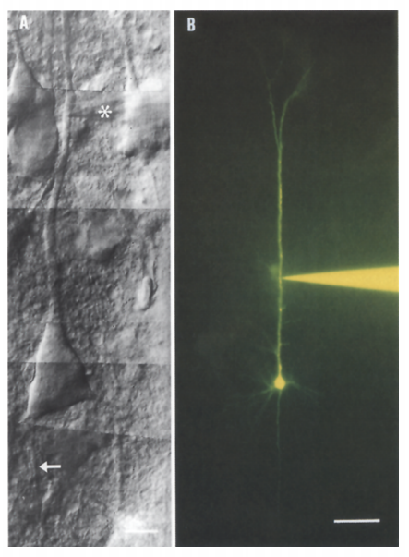
Space clamp

Slide 18
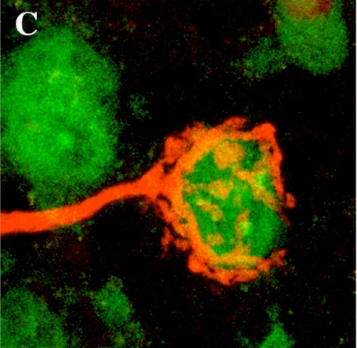
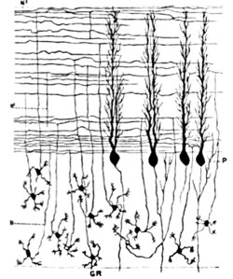
Overcoming space clamp
Aim big:
Squid giant axon
Calyx of Held
Dendritic recordings have so far targeted large dendrites
Aim small:
Cerebellar granule cells
Be careful, but not dismissive of the in between.
Achim Klug homepage UC Denver
Cajal

Slide 19
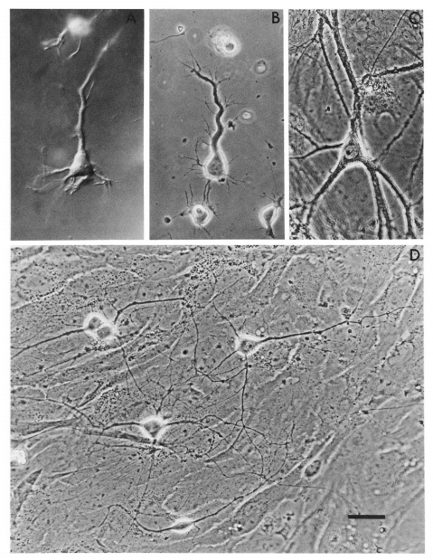
Dissociated neurons
Acute and cultured
Shortly after dissociating cells, neurons have relatively short processes. Voltage control of the cells will be roughly uniform.
As cells are maintained in culture, processes extend and the quality of space clamp decreases.
Cultured neurons can allow genetic manipulations that are not otherwise possible.
Cultured neurons may not be representative of neurons in the brain.
Huettner & Baughman 1986

Slide 20
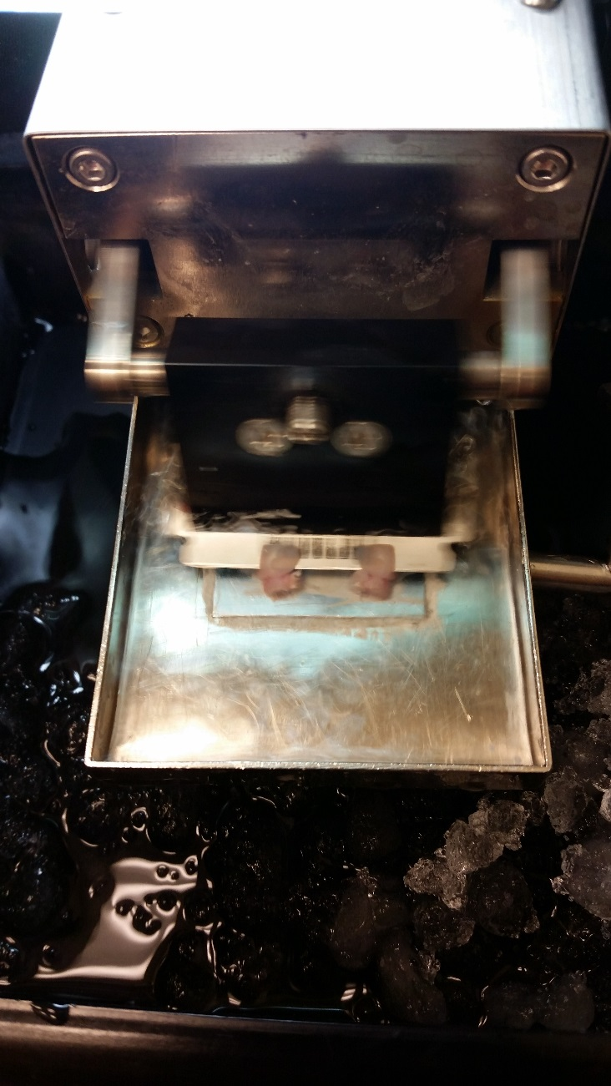
Acute slices
Live brain tissue is sliced in ~200 – 500 µm sections. Can be used for 6-8 hours after slicing.
Preserves small circuits while allowing for relatively quick application of drugs/blockers.
Preserves processes – space clamp can pose challenges.
Neurons in slices may not resemble those in in tact brain. Though typically thought to be more representative than cultured neurons.
Slices from adult mice can be more difficult to record from. Cell health degrades quickly.

Slide 21
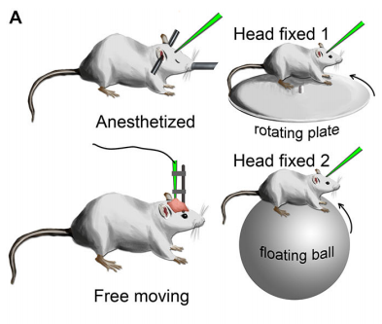
in vivo recordings
Neural recordings in an in tact brain. Sometimes only partially in tact.
Allows recording of neural activity and function in behaving animals in response to sensory stimuli.
Experiments used to be more limited to extracellular recordings, but in vivo patch clamp is becoming more common.
Typically used for superficial regions of the brain (like cortex). Recordings from deeper structures may require careful removal of other structures.
Requires small/high resistance pipettes. You won’t have the experimental repertoire available with slices or dissociated cells.
Technically demanding.
Tao et al., 2015

Slide 22
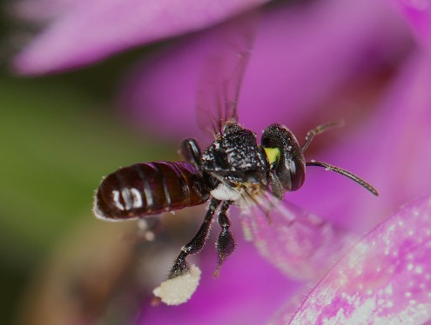
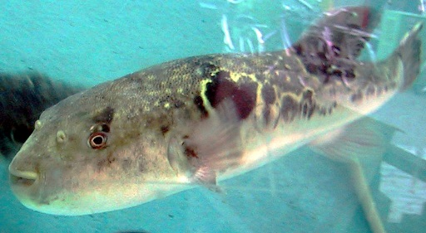
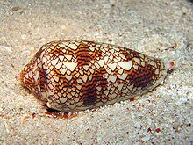
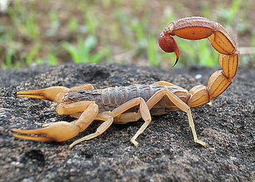
Toxins and drugs for isolating currents
Many naturally occurring toxins block or modulate channel activity.
Tetrodotoxin (TTX) from pufferfish fugu blocks voltage-gated Na⁺ channels. A deadly delicacy.
Apamin from bees blocks small conductance Ca⁺⁺ activated K⁺ channels.
Conotoxin – several different variants block specific ion channels. From cone snails
Iberiotoxin – from scorpions blocks large conductance Ca⁺⁺ activated K⁺ channels.
Growing list…
Wikipedia.org

Slide 23
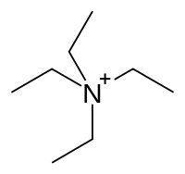
Toxins and drugs for isolating currents
Investigations into ion channel function have revealed many synthetic ion channel blockers/modulators.
This is an active area of pharmaceutical research. Arguably second most common drug target (after GPCRs).
Tetraethylammonium (TEA) blocks K⁺ channels.
Many small ions are channel blockers Cs⁺ blocks hyperpolarization-activated current.
Also a growing list. Important to keep specificity in mind when interpreting experiments.
Wikipedia.org

Slide 24
Electrophysiology Methods Overview
There are many variants on these techniques and other important considerations that you will come across in the remainder of the course and your career in neuroscience.
The basic principles always apply. Ohm’s law never changes, the atomic mass of carbon is 12, etc.
Different paradigms have unique advantages and disadvantages. The most successful scientists will balance skepticism and enthusiasm towards their own work and others’.

Slide 25
Notes
The Raman & Bean paper examines some channel/current types that we haven’t discussed much in class.
May be useful to read Chapter 11 Molecular Properties of Ion Channels before reading the paper.
No office hours on Monday.

